Slide 1
Long Live the Soil App Usability Test Results
CS5760 Students: Nichole Mackey, Ruby Periera
HU4628 Students: Ben Guo, Brady Opsahl, Daniel Woirol

Slide 2
Usability Test Results
Nichole Mackey

Slide 3
Long Live The Soil App Overview
Developed for Oklahoma State Soil Health Coordinator
Users: Oklahoma landowners
Functionality
User
Post questions
View resources
View news & relevant events
Admin
Answer questions
Update resources
Update app content

Slide 4
Testing Procedure
Overall pre- & post- test questions
Three scenarios
Posting a question as user
Finding a resource as user
Adding new resource + answering a question as admin
Post-scenario questions and interviews
Notes:
Both qualitative and quantitative data collected

Slide 5
Usability Test Results
Pre-Test Results
Years using smartphone
4 years - 1 participant
5-6 years - 1 participant
8 years - 3 participants
Interested in app
Very much - 2 participants
A little bit - 2 participants
Neutral - 1 participant
Post-Test Results
Easy to perform tasks
Strongly agree - 2 participants
Agree - 3 participants
Enjoyed using app
A little bit - 4 participants
Neutral - 1 participant
Use app again
Very much - 3 participants
A little bit - 2 participants

Slide 6
Bug Report
Google authentication for login tied to browser cookie
Severity: moderate
Duplicate counties in dropdown menu, admin adding new Resource
Severity: minor
“isVendor” wording when adding new Resource as admin
Severity: minor

Slide 7
Recommended Changes
Login process for posting questions
Redirects to homepage
Change wording of adding resources
Button says “new professional”
“Simplifying” process of answering questions for admins
Notes:
more details in your Usability Test Report, and will be posted on your website
Introduce Ruby as next presenter

Slide 8
Usability Test Results
Ruby Periera

Slide 9
Testing Procedure
Description of the application, pre-test questions and declaration
Description of the test scenarios
Login and posting a question as user
Finding a resource and a news article as user
Adding new resource, adding a new news article and answering a question as an admin
Post-scenario questions and feedback

Slide 10
Usability Test Results
PRE TEST QUESTIONS
Comfort while using a Computer
Highly Comfortable - 3 participants
Proficient - 3 participants
Level of Interest in testing this App
Interested - 4 participants
Somewhat Interested - 2 participants
How familiar are you with the soil Conversation App
Not at all - 3 participant
Not very Much - 2 participant
A little bit - 1 participant

Slide 11
Usability Test Results
POST TEST QUESTIONS
Experience in Using Application
Very Good - 4 participants
Good - 2 participants
Using the application again
Yes - 3 participants
No - 3 participants
Ease of Use
Very Easy - 4 participants
Easy - 2 participants
Information Clear on the website
Yes - 6 participants

Slide 12
Bug Report
After creating a new professional, the back button on that page takes you back to create professional form page. (Admin)
Severity - Moderate
Creation of an empty news article and new professional. (Admin)
Severity - Extreme
No edit button for editing the news article if it is a direct link. (Admin)
Severity - Extreme
When accessing the news article and if it’s a direct link there is no way to come back to the soil health website. (User)
Severity - Extreme

Slide 13
Recommended Changes
The wordings of some buttons needs to be changed to more readables one.
‘Add professional’
‘isVendor’
‘Direct Link’
Having a consistent back button
Making the question submitted feedback larger
Having sub questions or comments for each question.

Slide 14
Usability Test Results
Ben Guo, Brady Opsahl, Daniel Woirol

Slide 15
Test Procedure
Pass out scenario sheet
Log in
Find resource of an assigned county
Check a random article
Post the question found on the scenario sheet
Answer the question found on the scenario sheet
Record Observations
Bug Report
User Opinions

Slide 16
Usability Test Results
Observations
Difficult for users to find their county from the home page
No indication if a news article will link to an external site or not
No form of spell check throughout the site
User Opinions
Home page image of Oklahoma is too low of a resolution to read easily
County and city have the same font on the map. It is hard for non-Oklahoma resident to locate the county
Liked the color scheme

Slide 17
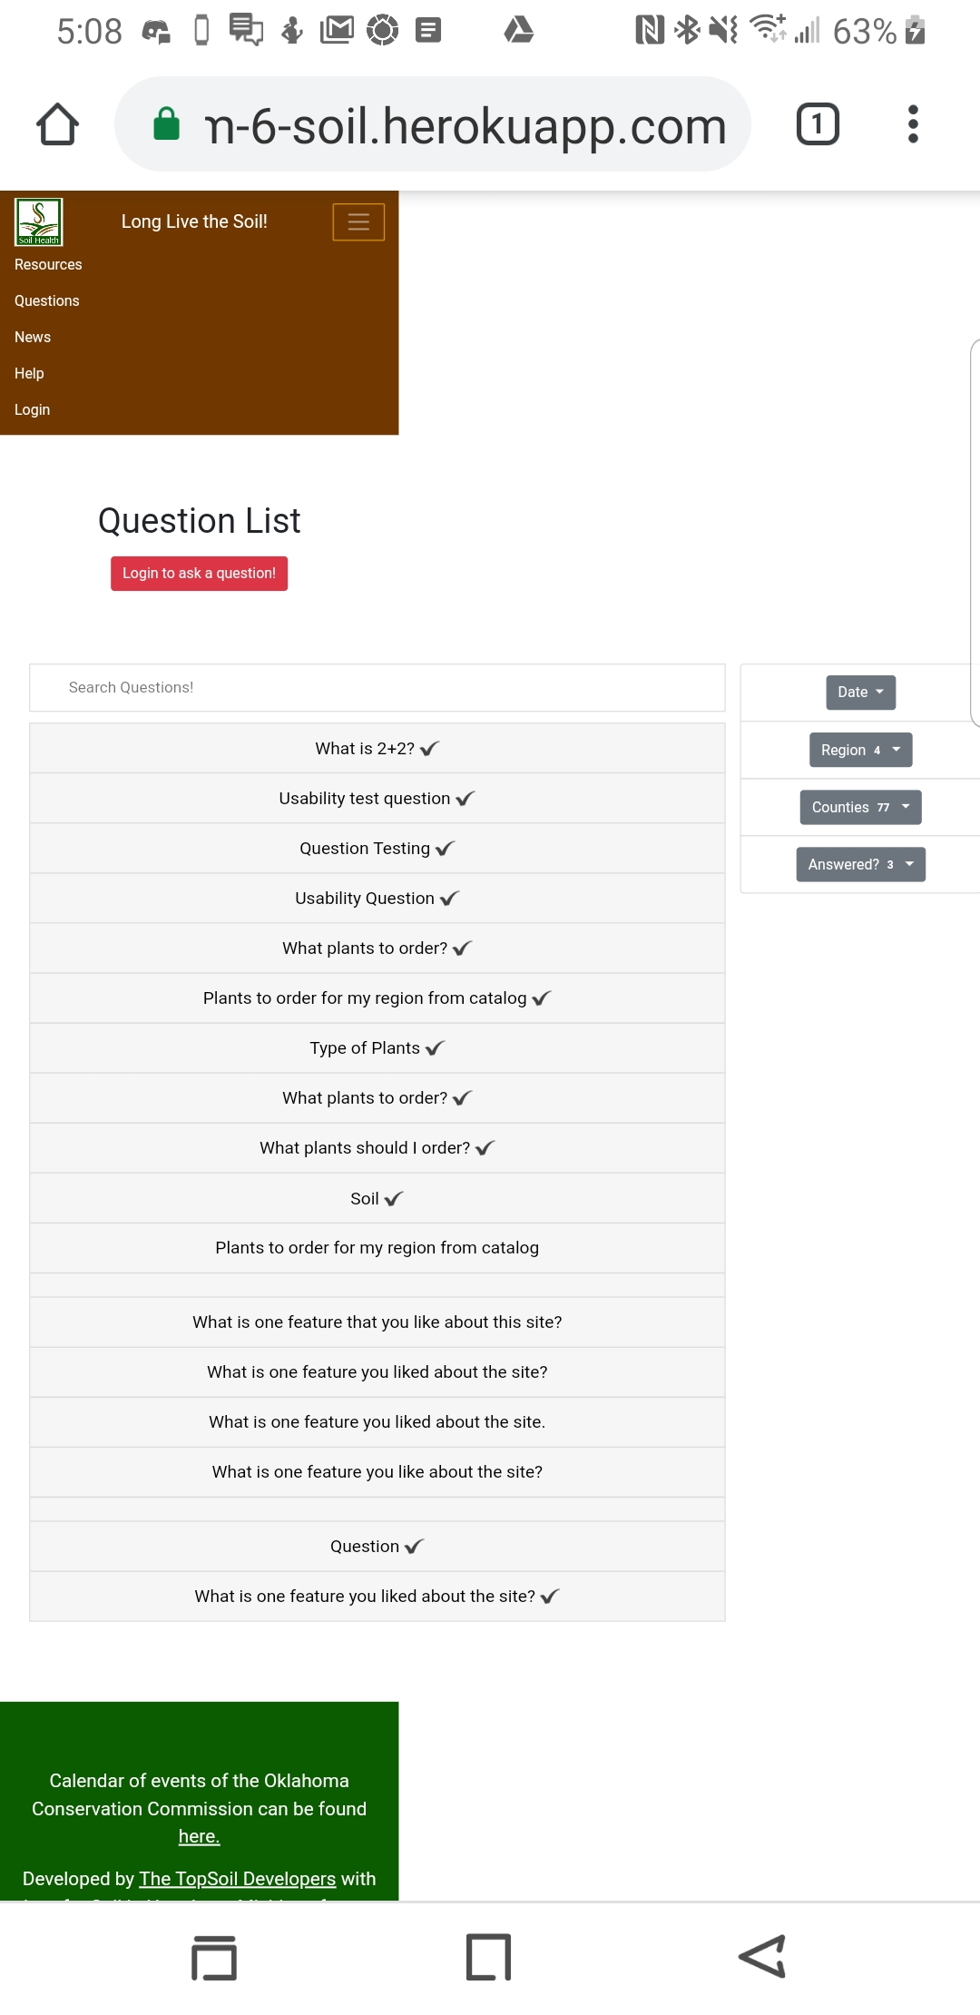
Bug Report
Search filters do not work
Site elements do not line up properly in mobile view
Allows users to post untitled questions
Unable to search/edit/delete untitled questions
Must connect via HTTPS in order to log in, no indication for the average user

Slide 18
Recommended Changes
Implement search filters
Implement spell check
Provide some form of warning if a link would send you away from the site
Make sure that site elements are aligned on mobile
Let users find their region by county
Maybe change the map image to something easier to read

